Slide 1
Color DMS UI Updates
Following Initial Design Review

Slide 2
Second Design Review
Comments from preliminary design review were solicited from districts
Comments were consolidated for consideration by CO
After evaluation by CO, list of approved changes was developed
These mock ups represent the changes approved following the preliminary design review

Slide 3
Feedback Still Needed
Dialogs are much closer to finalized, but could still be tweaked
If any showstoppers are present, please speak up

Slide 4
List of Dialogs Modified
DMS
Graphic mgmt.
Short status
Full status
Send message
Message libs.
Sequence libs.
Sequence edit
MAS
Queue manager
Device queue
C2C
Message approval
Short status
Full status
EM
Response plan
Suggested plan
Predefined plan
TvT
Tabbed UI
Add’l support dialogs

Slide 5
Common Modifications
The following features and modifications are present in each dialog where appropriate
New background / color theme
Alternating row colors
Grid header sort / filter
Grid column selection
Many functions will be available through context menus rather than on-screen buttons
Find on Map
Collapse / expand all

Slide 6
DevExpress WPF Toolkit
Many features are dependent on third party WPF GUI control toolkit
May not have ability to change implementation of features without selecting alternate toolkit or building from scratch
Per-developer license fee required
Starts at $900/seat, reduced for multiple seats
Includes: Data Grid, Ribbon, Toolbars, Charts, Scheduler, Tree Grid, Docking, and more controls

Slide 7
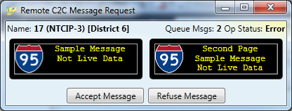
C2C: Remote Message Approval
No significant changes
Ribbon controls not added
Size of ribbon too large for dialog

Slide 8
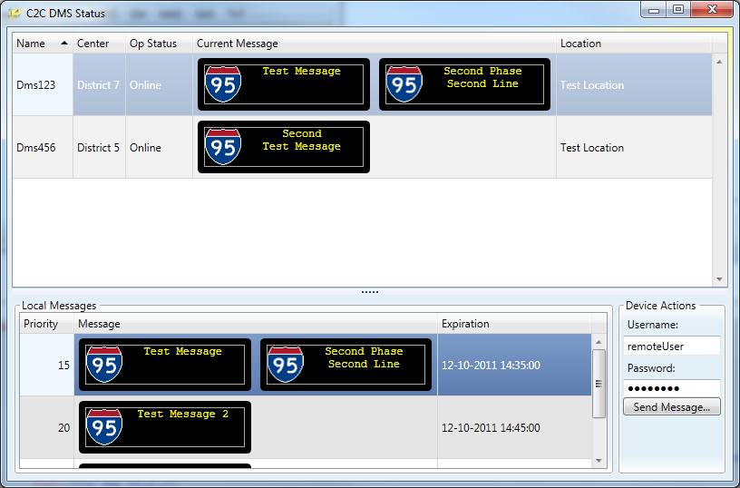
C2C: Full DMS Status
Moved filtering to headers
Username / password may be updated in future

Slide 9
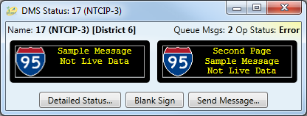
DMS: Short status
No significant changes from previous mockup
May be replaced by map tear-away in future release

Slide 10
DMS: Send Message
Add / Remove page buttons replaced by icons
Color dropdown will show items colored
Graphic dropdown will show image folder structure
Message search moved to top of dialog
New buttons: Save to Library, Show Queue, Collapse All (Libraries)
Show / Hide Library controls
Tree icons
Note: Ribbon not added because edit control used in multiple places
Integrating ribbon into each dialog would require additional effort

Slide 11
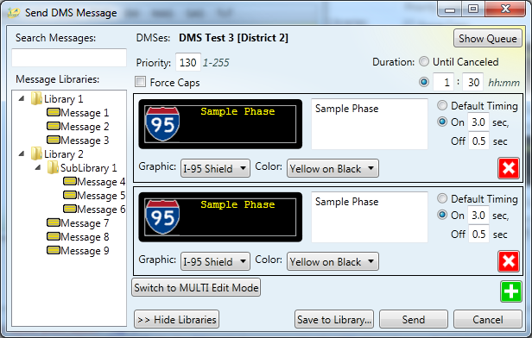
DMS: Send Message (cont.)

Slide 12
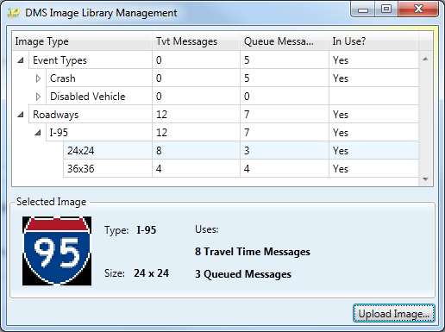
DMS: Image Management
Removed sub-dialog
Context menu
Add
Rename
Delete
File Open Dialog, selected image added to selected folder

Slide 13
DMS: Message Libraries
Modified layout to differentiate from Send dialog
Provides filter / sort controls in grid
Shows simplified version of message text
Could provide graphic version as user option
Uses multiple changes, save once approach
Add / Remove page buttons replaced by icons
Color dropdown will show items colored
Graphic dropdown will show image folder structure
Removed Priority field
Not currently stored in DMS
Will add enhancement if schedule / budget allow

Slide 14
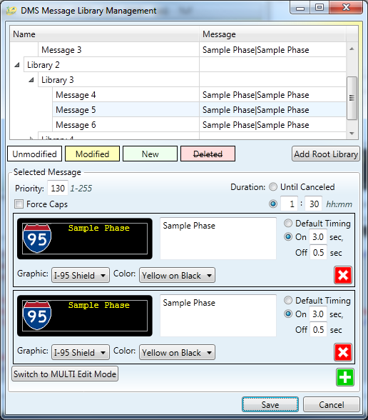
DMS: Message Libraries (cont.)

Slide 15
DMS: Sequences
Sequence functionality has been removed from DMS
New support will be added for DMS message control through SAS

Slide 16
Message Management
Ribbon layout modified
Roadway / direction column added
Next Message column available for selection by user

Slide 17
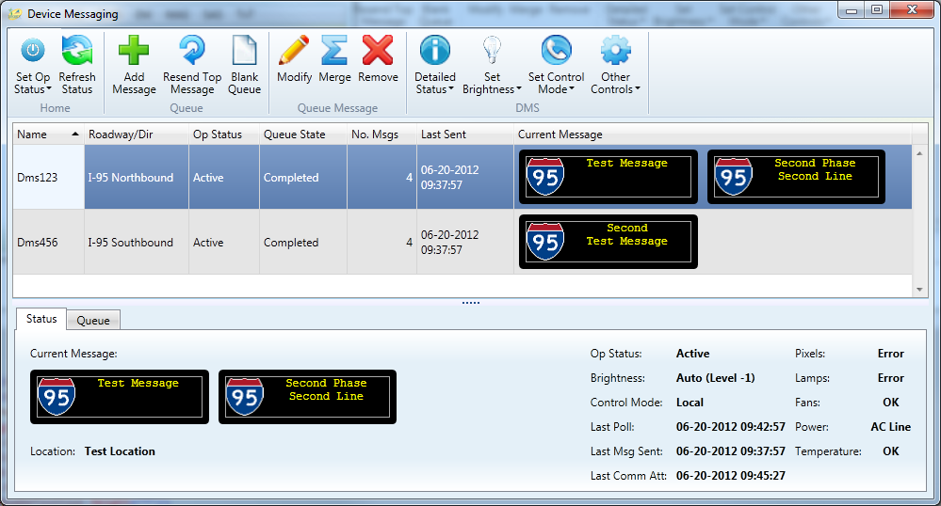
Message Management (cont.)

Slide 18
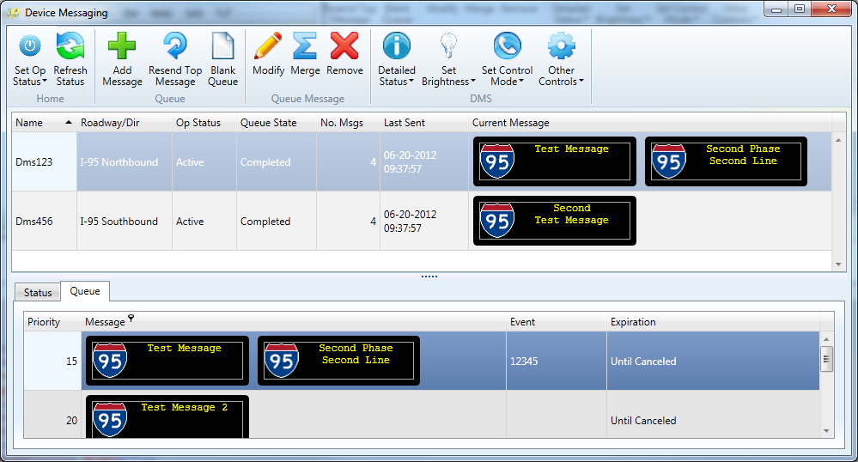
Message Management (cont.)

Slide 19
Travel Times Tab
Moved button commands to Ribbon bar
Find on Map moved to context menu
Description column available through column chooser
Using third party grid control for filter / sort support
Provides individual expansion of detail rows not available in default Microsoft control
Rearranged elements of DMS display to reduce vertical space use
Not implementing tabbed dialog in this release
Comprehensive tabbing / docking solution needed

Slide 20
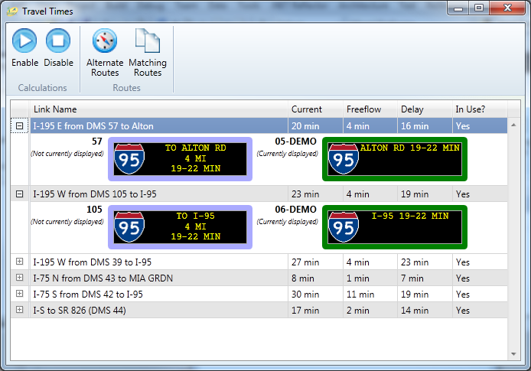
Travel Times Tab (cont.)

Slide 21
EM: Response Plans
Current Plan message borders colored based on posting state (also displayed as text)
Suggested messages with no change shown grayed out
Priority in lower right of messages
Could display “Priority” as tooltip if hovering over number

Slide 22
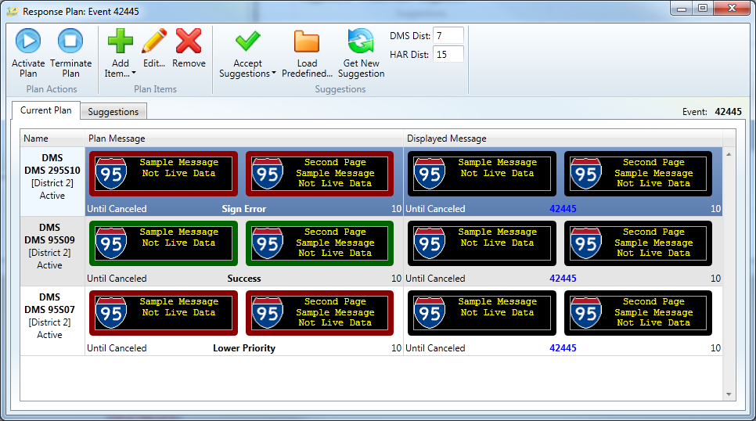
EM: Response Plans (cont.)
Current Plan view:

Slide 23
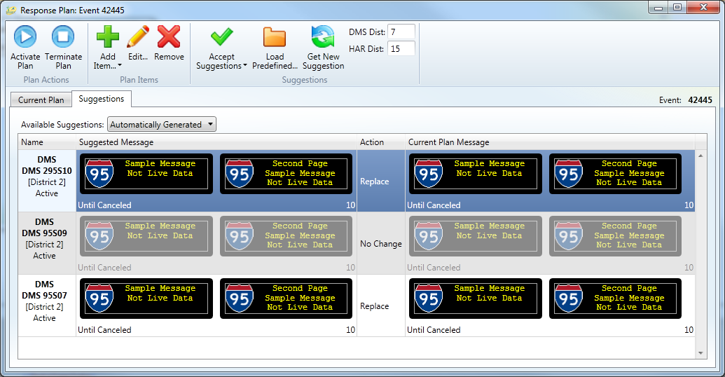
EM: Response Plans (cont.)
Suggested Plan view:

Slide 24
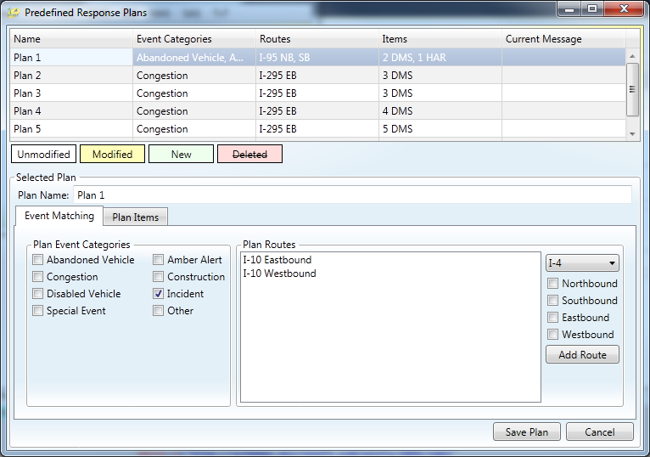
EM: Predefined Plans
Using multiple changes, save once approach
Event Matching view:
Plan context menu
Add
Delete

Slide 25
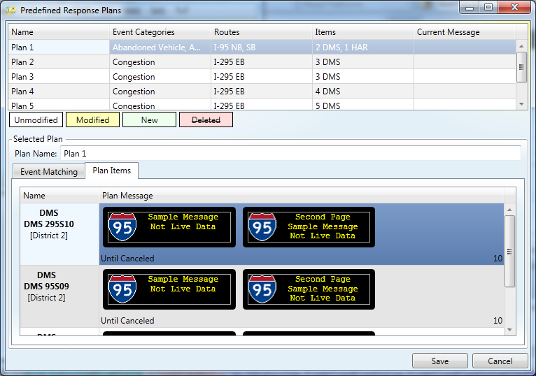
EM: Predefined Plans (cont.)
Plan Item view:
Plan item context menu
Add
Edit
Delete

Slide 26
Scheduled Actions Updates
Following Initial Design Review

Slide 27
SAS: Schedule Overview
Replaced previous calendar control
Third party toolkit used for data grids and ribbon also includes schedule calendar control
Full functionality will be evaluated and additional features incorporated where possible
Added month view calendar control
Added visibility checkboxes to list of schedules
Context menu
Add
Edit
Delete

Slide 28
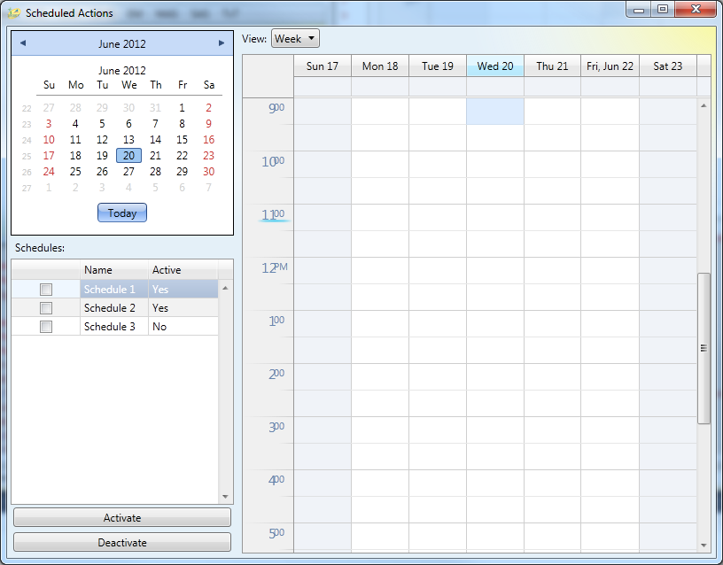
SAS: Schedule Overview (cont.)

Slide 29
SAS: Schedule Item
Only using Managed mode for Travel Times / schedule enable / disable
Added support for DMS items

Slide 30
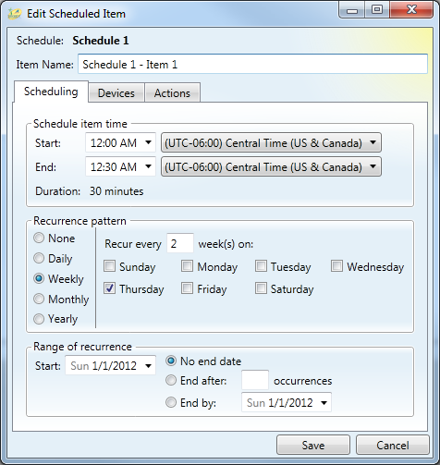
SAS: Schedule Item (Timing)

Slide 31
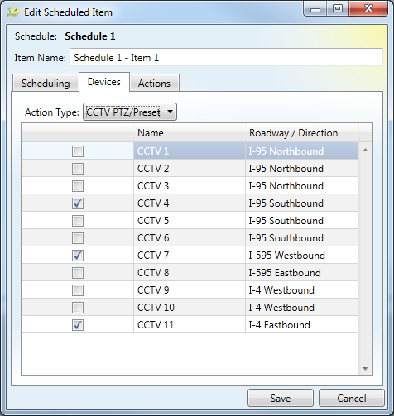
SAS: Schedule Item (Devices)
Modified to use sortable / filterable grid

Slide 32
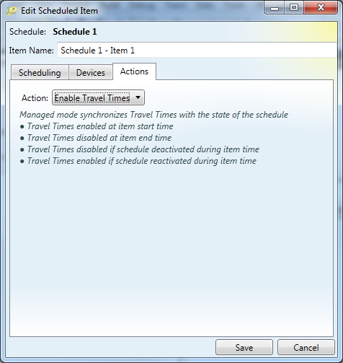
SAS: Schedule Item (Travel Times, Schedules)

Slide 33
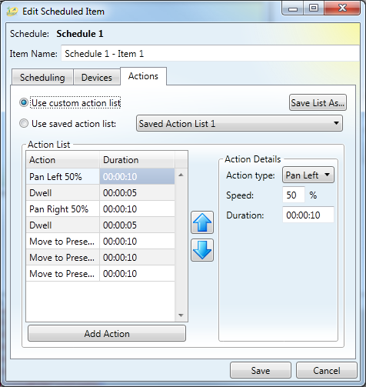
SAS: Schedule Item (CCTV)

Slide 34
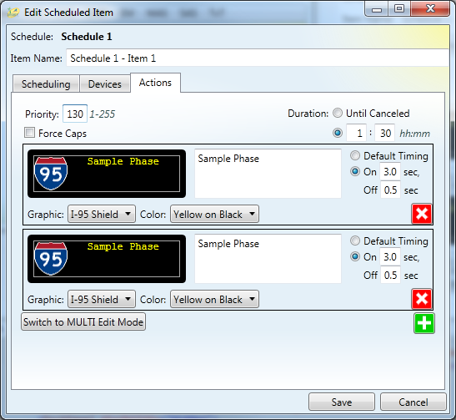
SAS: Schedule Item (DMS)

Slide 35
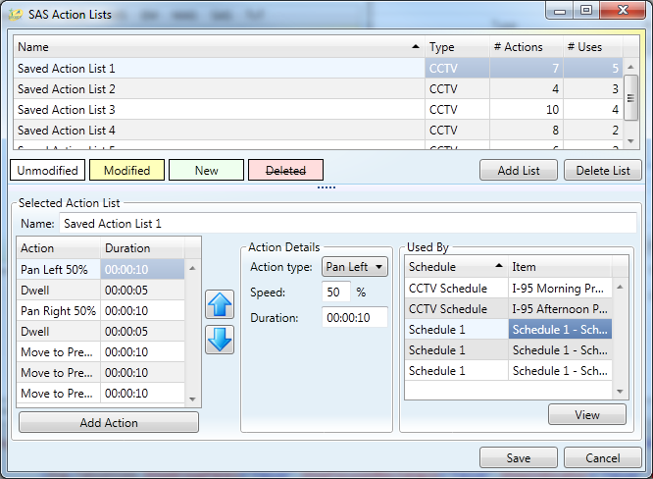
SAS: Action Lists
No major changes

Slide 36
Future SAS Enhancements
New structure of SAS could allow additional items to be scheduled.
HAR
TAM (Connected Vehicles)
Enable / disable Incident Detection devices
Report generation
Video switching
Pricing mode changes
Event actions could be scheduled
Event creation?
Response plan activation only?

